Slide 1

Expert Systems- Application of AI
Ms. Swati Mali

Slide 2
Outcomes
By the end of this module, you’ll be able to:
Understand the concept of expert systems
Explain components of expert system
Explain the role in expert system implementation
Understand process of building expert systems
Define characteristics of expert systems
Know applications, advantages and limitations of expert systems

Slide 3
Definition
An intelligent computer program that employs knowledge and inference procedures to solve problems that are considered difficult enough to require significant human expertise for their solutions.

Slide 4
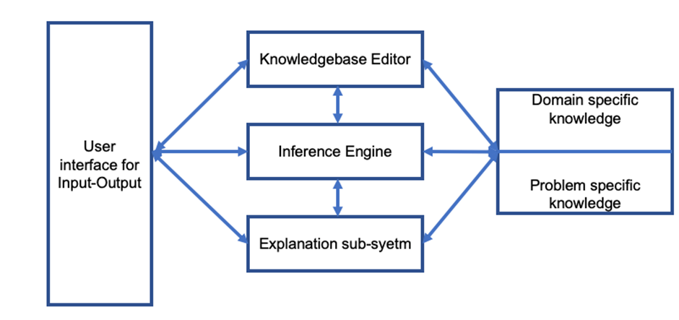
ES component diagram
Rule Based Reasoning
Case Based Reasoning

Slide 5
ES components: User Interface
Users interact with ES through this user interface to give input and to receive output.
Various ES in the world use different interfaces to communicate with the user.
Some of the examples are-
Input-
speech input through a microphone,
forms,
questionnaire,
dialogue boxes,
various sensors,
command prompts, etc.
Output-
speech through speakers,
graphs,
actions such as modem dialing a phone number,
graphical output,
textual results, etc

Slide 6
ES components: Inference Engine
The inference engine is the brain of the ES.
Contains customized algorithms, rules, reasoning methods, etc. to solve a specific problem.
Interacts with the Knowledge Base to receive appropriate background and current information, facts-rules/ algorithms to apply to answer the user's query.
Uses various options to compute solution.
Some of the algorithm families used by inference engine are-
Forward/backward chaining
if-then-else condition-action rules
2. Machine learning algorithms
3. Neural networks
4. Bayesian network
5. Decision trees
6. Customized algorithms

Slide 7
ES components: Knowledge base
The knowledge base is a collection of facts and the rules.
The success of the Expert System mainly depends on the highly accurate and precise knowledge.
The knowledge is generally a domain-specific one.
The knowledge is typically divided in two parts- domain specific knowledge and problem specific knowledge.

Slide 8
ES components: Explanation subsystem
The explanation subsystem is something unique to ES.
When asked, the ES can explain its reasoning process of starting with the given information to all the intermediate states during the computation process.
This can help in debugging where one can pinpoint missing a fact or a rule.
It is also helpful in case of difference of opinion and it can be very well bounded by having access to the customers.

Slide 9
Roles in building expert systems
Domain expert
one or more domain experts might be involved in the project.
The domain expert beholds hefty proficiency in the domain for which the expert system is under development.
It’s not compulsory for the domain expert to have knowledge about AI, expert systems or computer programming
Knowledge engineer
generally more than one knowledge engineers work on project.
A knowledge engineer is specialized in the field of AI.
Possess knowledge on computer programming and is perhaps a computer scientist or programmer, who is expert in the field of building expert systems.
Typically, the system designers, programmers, testers, analysts, i.e., all of those who have worked on technical aspect of expert system development are believed to be knowledge engineers.
The knowledge engineer should be well acquainted with-
various of knowledge representation techniques
intelligent searching strategies
expert system tools
software engineering methodologies those formalize the process and can also speedup the development.
Other expert systems working on similar problems or domains so as to understand their strengths-weaknesses and thus adapt the best practices, avoid mistakes in the expert system being developed.
User

Slide 10
Characteristic of Expert System
The expert systems are efficient, accurate and solve complex problems like any other human expert.
Provided that ES are well equipped with the knowledge to make decisions, they are highly reliable and error-free.
The knowledge base editor keeps the ES Flexible and open to adopting new knowledge.
The ES have the ability to handle complex and challenging decision-making problems.
Performance of the expert systems is characterized by quantity and quality of the knowledge integrated in the ES program.

Slide 11
Applications of expert systems
Helping investors with Financial investments and risks’ management
Helping doctors for medical diagnosis, especially in remote medicine facilities
Exploration of oil fields in oil industry.
Maintenance and repairs of equipment in manufacturing industry.
Management of complex production processes.
Help desk management
Malicious software detection
Anomaly detection
Cargo and airline scheduling
Stock market analysis
Profile analysis for loan approvals etc

Slide 12
Advantages of Expert Systems
Schooling and educating human workforce for an expert’s position is quite an expensive affair. The human experts may change job, may retire or may get tired with age. On the contrary, a computerised system is comparatively easy to build, can take input from multiple human experts, can be relocated, modified, copied at many places, can be put to work for extensive hours.
The ES software has high availability and will not need vacation or fall ill etc.
Accumulated knowledge of multiple human experts may help in improvement of decision quality
The consultation from human experts is also a costly affair; their availability is another issue altogether. Investment into a good ES might be just one time cost than paying per session fees.
If implemented properly, ES is quite Fast and accurate and has less chances of human errors
ES are free from human virtues such as emotions, tensions, anxiety and fatigue.
ES holds tremendous amount of information and doesn’t forget to consider even tiniest bit of information while suggesting output(s), provided they have all the knowledge needed to make decisions.
Human experts aren’t immortal, but expert systems last longer, they can be modified as the knowledge and technology changes.
Human experts sometimes act unpredictably to human nature, comparatively, expert systems are quite consistent.

Slide 13
Limitations of the expert system
ES typically cannot give a reasonably accurate and reliable response in an unforeseen situation
The knowledge is very vast and voluminous. Missing facts and rules in KB, uncertainty can make the ES give incorrect suggestions/decisions.
Building and maintenance cost of an expert system is very expensive
An expert system can combine knowledge of multiple human experts and give decisions accordingly, but it cannot be creative in similar situations. Rather, it would give almost same answer every time in those similar situations.
A human expert can logically give decisions in other domains, but an ES will work only for specific domain and will fail tragically when faced with problem that is out of the scope of the chosen field.
The ES cannot be flexible and adopt new learnings unless its programmed to do so.
The initial setup cost and time taken by ES is expensive than using a human expert.

Slide 14
Differences between Neural Networks and Expert Systems
Both expert systems and neural networks help users in decision making process. But the difference lies in their processes.
An expert system gets the input through user interface. The inference engine then combines domain-specific and case-specific knowledge with the algorithmic processes contained in itself. The result is thus computed by inference engine and given to user through user interface to view.
Neural networks use layers of neurons and non-linear in structure. They use previous patterns, samples, and inputs and outputs to make decisions.
Example- a crime related expert system will analyse crime to give suspect, culprits and motives while neural network evaluation will be to figure out crime patterns and growth etc.

Slide 15
Examples of Expert Systems
MYCIN: Mycin is one of the earliest expert system built in 1960’s for medical diagnosis purpose. It took answers to series of questions in yes or no forms, used more than 600 simple inference rules and used backward chaining to give output. It could also give drug prescription to the patients.
DENDRAL: This was another expert systems from 1960s and many expert systems, including Mycin, were derived from it. Its purpose was to identify unknown organic molecules. It used some graph theory algorithms for the same.

Slide 16
“Web Based Fuzzy Expert System for Lung Cancer Diagnosis”
Problem: the problem of detecting the lung cancer based on patients medical history.

Slide 17
Components
User Interface:
The UI consists of a form on a website.
The user must log in with their credentials (Medical Record Number) and the essentials details via a form on the website and the output is generated on screen with the diagnosis and the treatment suggestion.
General Knowledgebase:
The KB is stored in a MySQL database.
consists of variables like anamnesis, doubling, time of the tumour, degree of smoking, age and performance status.
Anamnesis in turn consists of several other variables like fever, genetics, chest pain etc.
The general knowledgebase consists of 243 combinations of rules obtained from doctors via interview. They consist of the 5 input variables; anamnesis, degree of smoking etc. and the corresponding output.

Slide 18
Components contd…
Inference Engine:
The inference engine uses fuzzy logic in order to perform a diagnosis.
The input variables are classified into fuzzy sets, and the weighted average of the fuzzy inputs is taken in order to the compute the final step.
Based on the weighted average, after de-fuzzification is performed, the tumour is either diagnosed as absent, benign or malignant.

Slide 19
Features of the expert system
The given expert system is able to diagnose lung cancer using fuzzy logic with rules based on interviews from doctors and supporting data.
The patients receive their diagnosis as well as a suggestion of the type of treatment required.
The patient is either classified as healthy, having a benign tumour or having a malignant tumour.

Slide 20
“Expert System for Financial Decision Making”
Problem- The Problem of deciding on the part of a consumer or a novice individual investor when to invest in the stock market and how to select what company’s share to buy in order to be able to get a good portfolio growth in the highly volatile stock market demands the development of expert systems for the novice investors.

Slide 21
Components of ES
User Interface:
Graphical User Interface like menus and graphics in the Windows Environment.
It enables the user to query the system, input the relevant information and then receive advice in the user’s language.
Knowledge base editor
The knowledge base editor is a simple editor that enables a subject matter expert to compose and rules to the expert system.
They can also convert the rules from one form to another.

Slide 22
Components contd…
Knowledge Base
It Consists of Facts, Rules or heuristic rules – specific rule of thumb. The Prolog suite is widely used to formulate the knowledge into rules and store them in the knowledge base.
Examples
falls (investment):- rises (interest rate).
rises (Investment):- falls (interest rate).
rises (interest rate):- rise (stock price).
falls (interest rate):- falls (stock price).
Knowledge acquisition captures the knowledge from a financial expert with adequate knowledge and experience in this field. Source of knowledge are online journals, databases, reports, etc.
The Case Specific data contains facts of problem that happen during the consultation process when the user in interacting with the expert system. It compares this information with the one found in the knowledge base and also stores the reasoning in the working memory.

Slide 23
Components contd…
Inference engine
An inference rule is a statement that has two parts- an if-clause and a then-clause. An expert system's rule base is made up of many such inference rules which resemble human reasoning.
The system uses Forward chaining and backward chaining for reasoning.

Slide 24
Summary
Expert systems are type of AI programs
Expert systems combine knowledge of multiple human experts and help the user in decision making.
Expert systems are highly knowledge-based systems.
User interface, knowledge base, inference engine, explanation subsystem and knowledgebase editor are main components of any expert systems.
Inference engine is brain of expert systems and has algorithms from various algorithmic strategy families to give output to the user.
Explanation subsystems is a unique feature of ES.

Slide 25
Summary contd..
Expert systems have applications in various areas in real life.
The expert systems are efficient, accurate, highly reliable, error-free, Flexible and open to adopting new knowledge
One can compare the human expert and expert systems for their performance to see ES are better than having just one human expert.
Neural networks and expert systems both help in decision making, but their working styles and outputs expected are different.
Though it comes with many positive points, the expert systems cannot handle unforeseen events properly. It simply cannot think out of the box.

Slide 26
Thank you

